Slide 1

Neural Network Models for Object Recognition Using Multi-Track ML Approaches
Feature Engineering + SVM/KNN Approach (Track 1)
Student ID: 219155

Slide 2

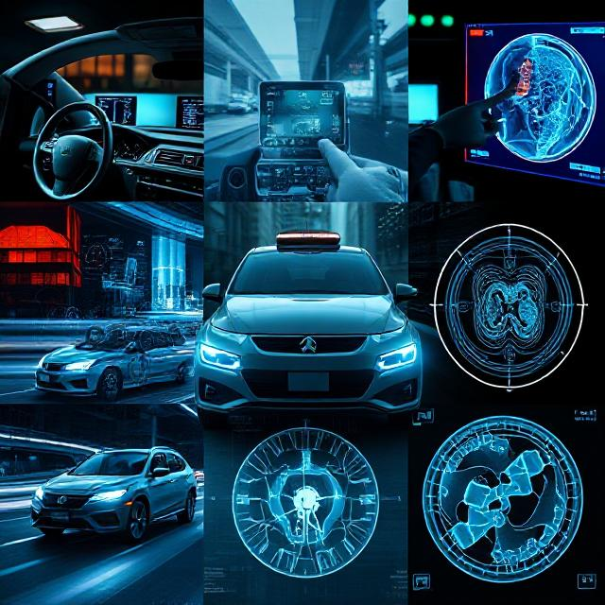
Problem Statement & Objectives
Object recognition is fundamental to many AI applications.
“These applications require researchers and application developers to gain advanced, broad, in-depth and up-to-date understanding of object recognition.” (Phuong Cao, 2011).
Main goal of this presentation is to demonstrate how carefully engineered features combined with traditional algorithms can achieve competitive results on the CIFAR-10 benchmark.

Slide 3
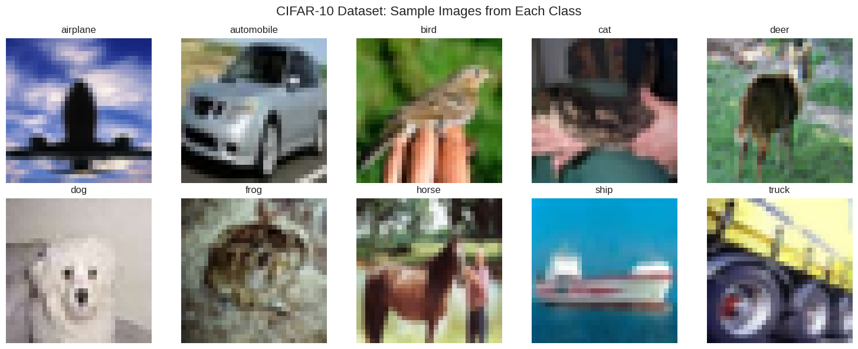
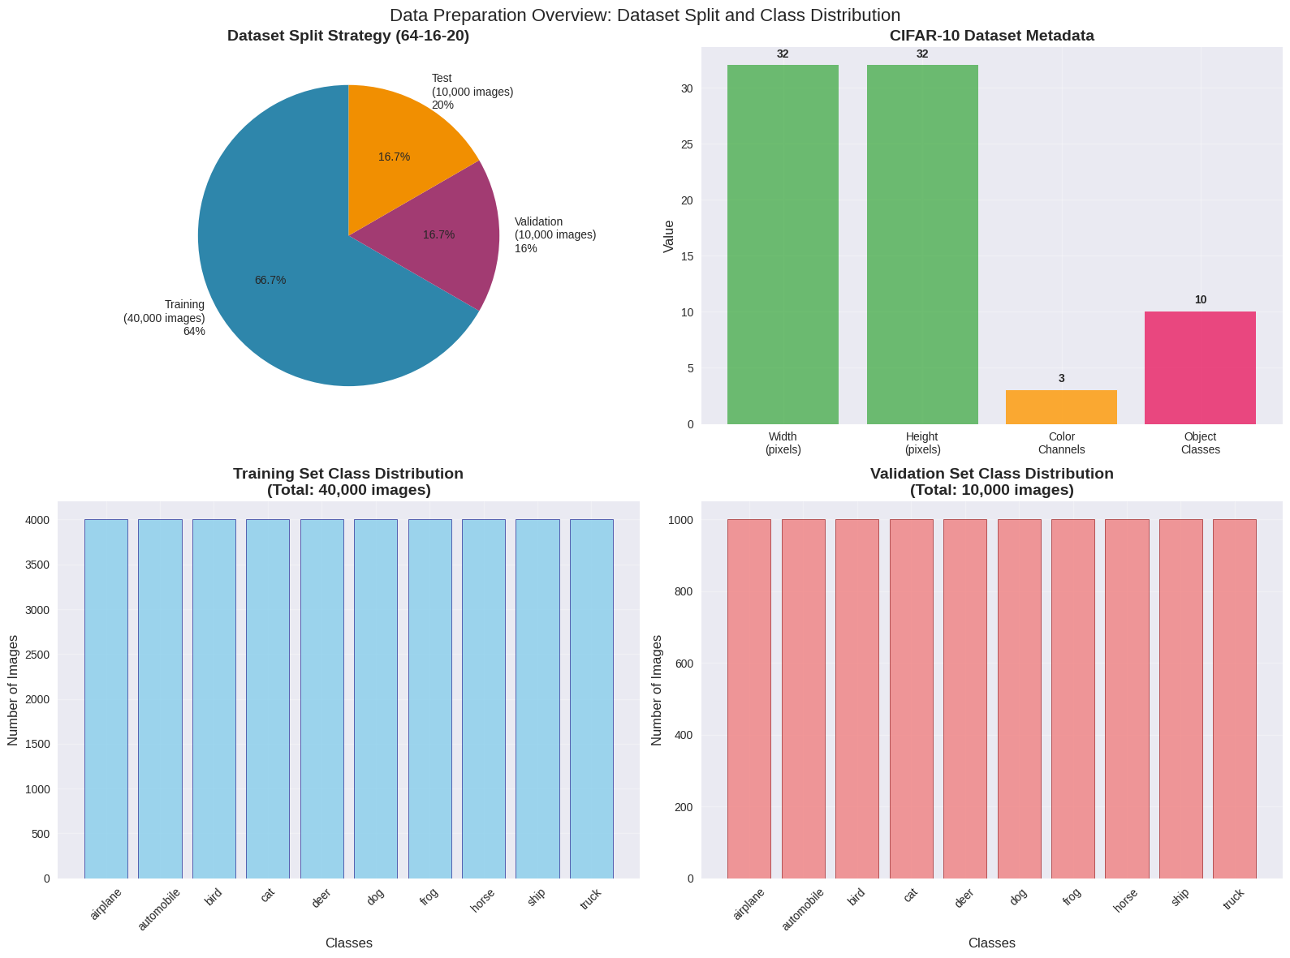
Dataset Overview & Preparation
CIFAR-10 = dataset with 60,000 32x32 color images in 10 classes containing 6,000 images each (Krizhevsky: 2009).
No traditional 80%-20% (training – testing) but 64%-16%-20% (training-validation-testing). Hyperparametric testing requires a proper validation set.
Metadata = 32x32 pixel format with 3 colors.
Class distribution = good balance (4000 images per class).

Slide 4

Validation Strategy
Validation:
Paramount for unbiased model evaluation.
Prevents under and overfitting.
Very important for hyperparameter tuning.
The dataset is split into three different parts:
- Training set => fit the models.
Validation set => estimate errors for model selection.
Test set => assessment of generalization error.
(Bartz et al., 2023).

Slide 5
Model Selection Justification
Comparative Table SVM / KNN
Aspect | SVM | KNN
Approach | Margin Maximization | Distance-based similarity
Complexity | Medium | Simple
Parameters | C, Kernel, Gamma | K, wights, distance metric
Strengths | High dimensional data, kernel trick | Intuitive, non-parametric
Speed | Fast Prediction | Slower prediction
SVM: kernel-based approach with a strong theoretical background, which has become a popular tool for machine learning tasks involving classification and regression (Oskoei et al., 2009).
KNN: does not train, from a technical point of view, a model to make prediction but classifies an observation based on the observations that surround it. (Albon, 2018).

Slide 6
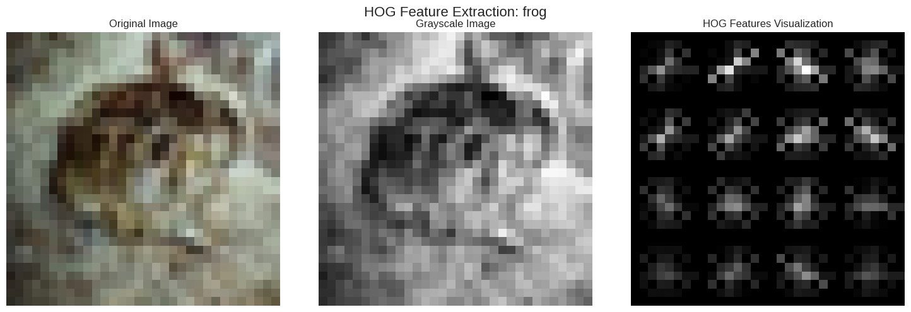
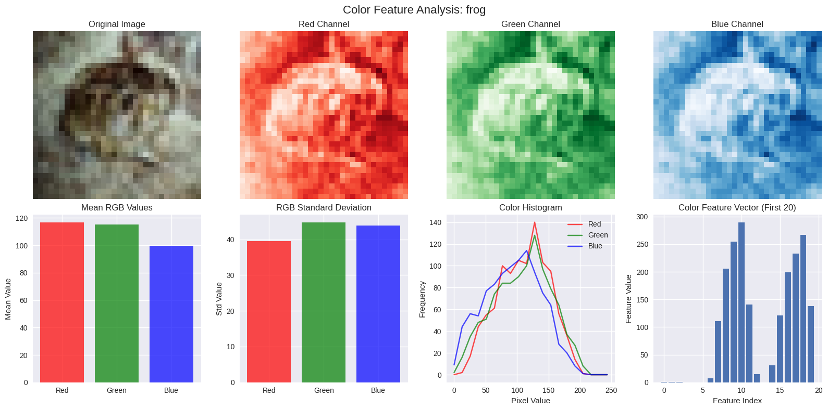
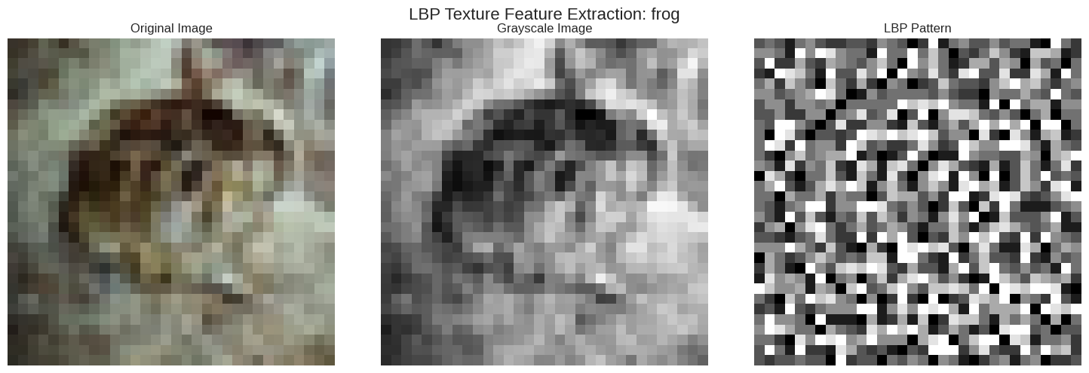
Feature Engineering Deep Dive
Feature Engineering transform raw data into valuable information for the machine learning model. The machine is able to “see” the pictures as a human would do.
Three features extracted for the dataset element “Frog”:
HOG Feature extraction.
LBP Texture Feature Extraction.
Colour Feature Analysis.

Slide 7
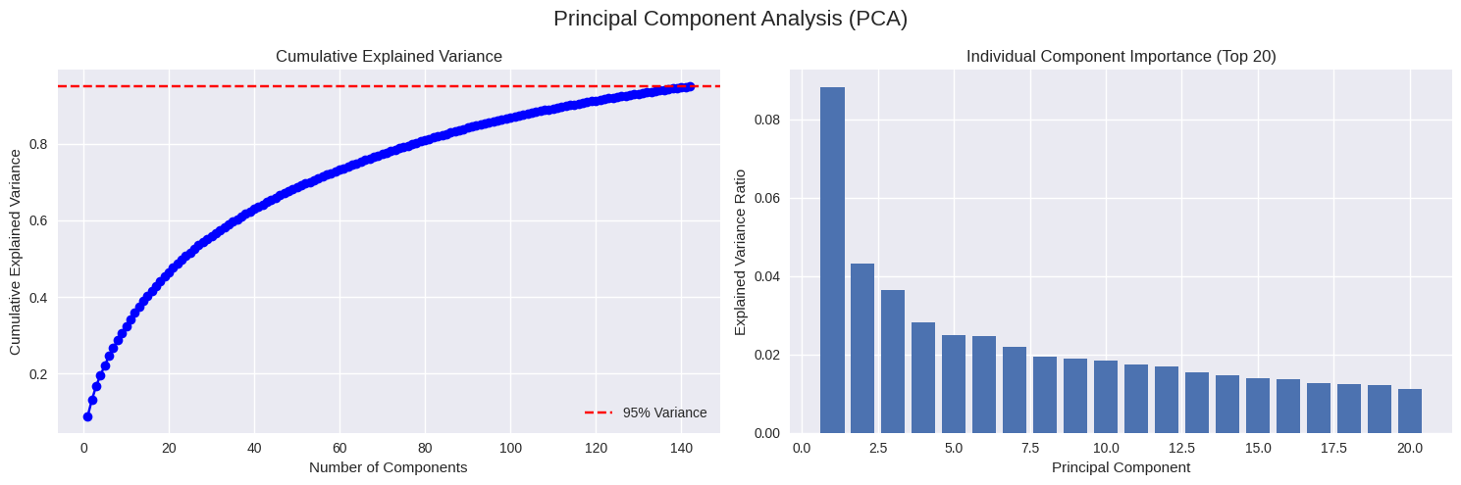
Architecture & Hyperparameters
Principal Component Analysis (PCA). Main reasons to perform this analysis:
- Reducing feature complexity.
- 95% variance retention.
- Using only 150 features => make SVM and KNN work faster and better.
- Overall performance improvement.
- Three-fold cross-validation has been finally used to select hyperparameters.

Slide 8
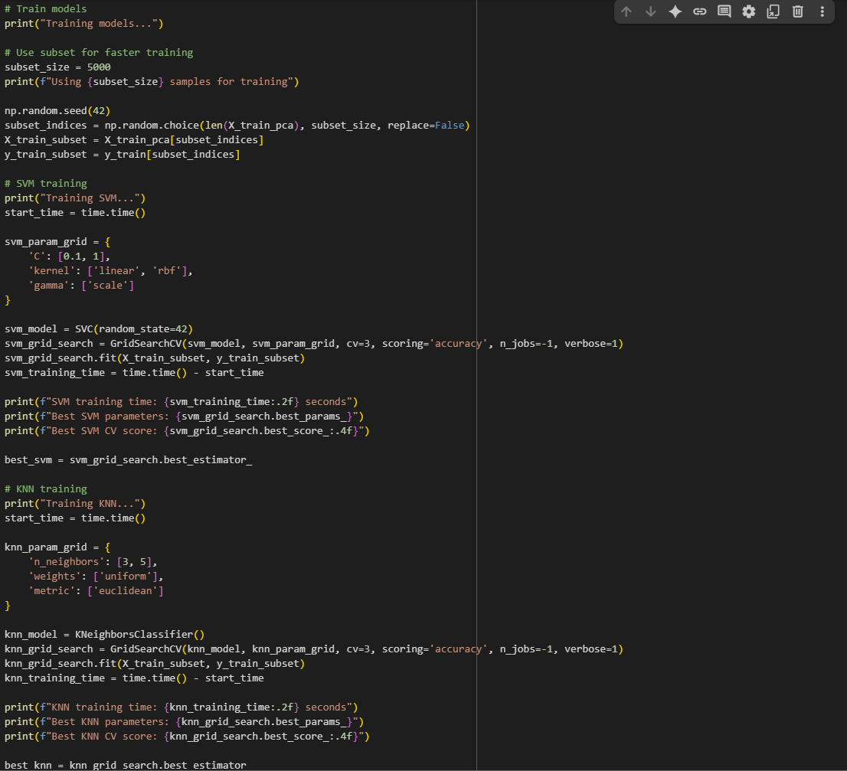
# Train models
print("Training models...")
Training Strategy & Methodology
Key points of Training Strategy & Methodology
Subset size: 5000 for faster execution.
3-Fold Cross-Validation: Robust performance evaluation during hyperparameter selection.
Parallel Processing: Utilizes all CPU cores (n_jobs=-1) for efficient training.
Performance Tracking: Measures and reports training time for each model.
Best Model Selection: Automatically selects optimal hyperparameters based on CV accuracy

Slide 9
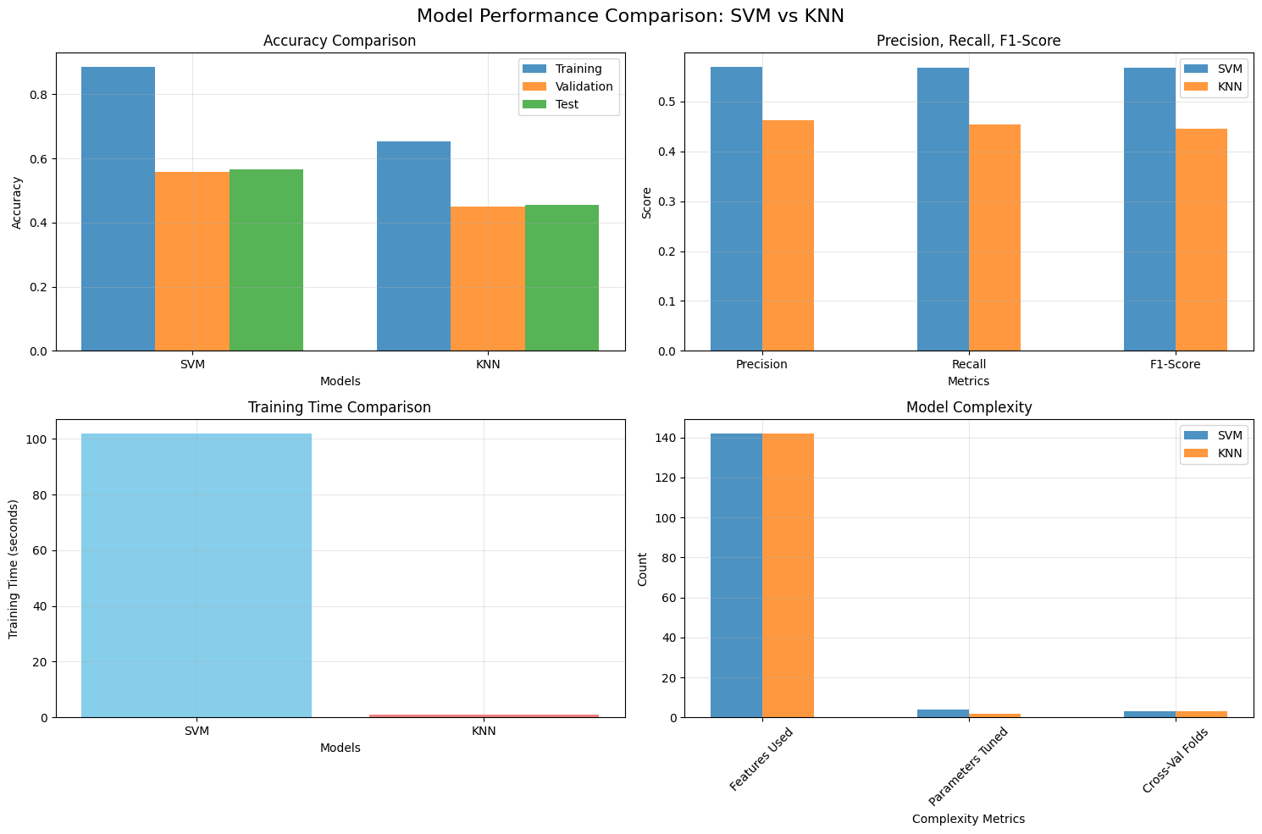
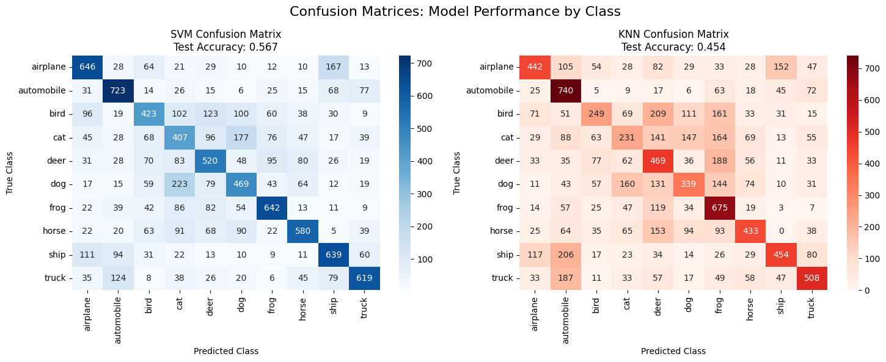
# Train models
print("Training models...")
Performance Results
Comparative Results of both SVM and KNN models:
- SVM Results:
Training Accuracy: 0.8850
Validation Accuracy: 0.5593
Test Accuracy: 0.5668
Test Precision: 0.5685
Test Recall: 0.5668
Test F1-Score: 0.56666
- KNN Results:
Training Accuracy: 0.6524
Validation Accuracy: 0.4488
Test Accuracy: 0.4540
Test Precision: 0.4621
Test Recall: 0.4540
Test F1-Score: 0.4455

Slide 10
# Train models
print("Training models...")
Comparative Analysis between Track 1, 2 and 3 (bullet points)
Advantages of classic ML:
Computational efficiency (shorter time for testing and training).
Dataset Performance: works well even with small dataset. No need to massive datasets for training.
Advantages of classic ML vs Deep Learning (Track 2):
Resources usage: less usage of resources of the pc and time saving.
Decisions: are more transparent and is more clear why the model makes certain predictions.
Disadvantages of classic ML vs Deep Learning (Track 2):
Weaker with more complex and larger dataset.
Image Recognition: in Deep Learning image itself can be used as input for image recognition while in classical ML the image has to pass few stages (feature engineering and feature extraction) to perform the image recognition. (Lai, 2019: 2).
Advantages of classic ML vs Advanced ML (Track 3):
Easy Implementation: straightforward and relatively simple coding, easy to modify without complexity.
Stability: results are stable and constant even after various runs.
Disadvantages of classic ML vs Advanced ML (Track 3):
Not based on automatic learning of features and not able to perform transfer learning (Chauhan and Singh, 2018: 349).

Slide 11
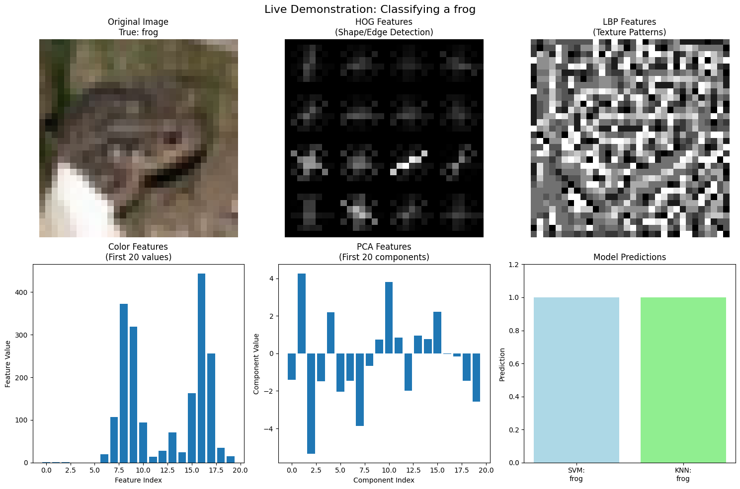
# Train models
print("Training models...")
Demo of Model with real run (code available in Appendix B)
Comparative Results of both SVM and:
Selected image: Frog (43).
Features extracted (HOG, LBP, colour).
PCA performed to reduce components.
Both models recognized the correct image => Frog.

Slide 12
# Train models
print("Training models...")
Conclusions
Overall Conclusions:
Best performing model within classical Machine Learning: Support Vector Machine (SVM)
SVM test accuracy: 0.567
Feature Engineering paramount to reduce dimension.
Despite reduced dimensions, PCA retained 95% of original variance.
Both model recognised the right image during live demonstration.
Classical Machine Learning:
- Provided a good and optimised solution for the Object Recognition model.
Helped with faster training and testing and with easy update and escalation of the phyton code.
Provide with decent visuals.
Future improvements:
Experiment and update the code with more features rather than only three used for this model.
Use Track 2 and Track 3 and compare results with the ones obtained with Track 1.

Slide 13
# Train models
print("Training models...")
References 1/2:
Albon, C. (2018) Machine learning with Python cookbook: practical solutions from preprocessing to deep learning. Beijing, China: O'Reilly. Available from: https://learning.oreilly.com/library/view/machine-learning-with/9781491989371/ch15.html#idm46702348467112 [Accessed 5th July 2025].
Bartz, E., Bartz-Beielstein, T., Zaefferer, M. & Mersmann, O. (2023) Hyperparameter Tuning for Machine and Deep Learning with R : A Practical Guide. 1st ed. Singapore: Springer. Available from: https://link-springer-com.uniessexlib.idm.oclc.org/chapter/10.1007/978-981-19-5170-1_2#Fig1 [Accessed 2nd July 2025].
Chauhan, N.K. & Singh, K. (2018) ‘A Review on Conventional Machine Learning vs
Deep Learning’, 2018 International Conference on Computing, Power and Communication Technologies (GUCON). Galgotias University, Greater Noida, UP, India, Sep 28-29, 2018. IEEE publisher. 347-352. DOI 10.1109/GUCON.2018.8675097 [Accessed 10th of July 2025].
Dhalla, A. (2020) Image Classification On CIFAR 10: A Complete Guide. Available from: https://ai.plainenglish.io/complete-guide-image-classification-on-cifar-10-chapter-i-multiclass-logistic-regression-525daee0775b#ce32 [Accessed last 11th July 2025].
Giuste, F.O. & Vizcarra, J.C. (2020) Cifar-10 image classification using feature ensembles. arXiv preprint arXiv: 2002.03846. https://doi.org/10.48550/arXiv.2002.03846 [Accessed 1st July 2025].

Slide 14
# Train models
print("Training models...")
References 2/2:
Hisham, G. (2022) Cifar10 classification. Available from: https://www.kaggle.com/code/gehadabdelghany/cifar10-classification [Accessed last 12th July 2025].
Krizhevsky, A. (2009) Learning multiple layers of features from tiny images. Technical Report 0. University of Toronto, Toronto, Ontario. Available from: https://www.cs.toronto.edu/~kriz/learning-features-2009-TR.pdf [Accessed 1st July 2025].
Lai, Y. (2019) A Comparison of Traditional Machine Learning and Deep Learning in Image Recognition. Journal of Physics: Conference Series 1314: 1-8. DOI 10.1088/1742-6596/1314/1/012148 [Accessed 10th July 2025].
Oskoei, M.A., Gan, J.Q., Huosheng, H. (2009) ‘Adaptive schemes applied to online SVM for BCI data classification’, 2009 Annual International Conference of the IEEE Engineering in Medicine and Biology Society. Minneapolis, MN, USA, 03-06 September 2009. IEEE. Available from: https://ieeexplore.ieee.org/document/5335328 [Accessed 5th July 2025].
Phuong Cao, T. (2011) ‘Preface’, in: Phuong Cao, T. (ed.). Object recognition. Rijeka, Croatia: IntechOpen. Available from: https://mts.intechopen.com/storage/books/81/authors_book/authors_book.pdf [Accessed 1st July 2025].

Slide 15
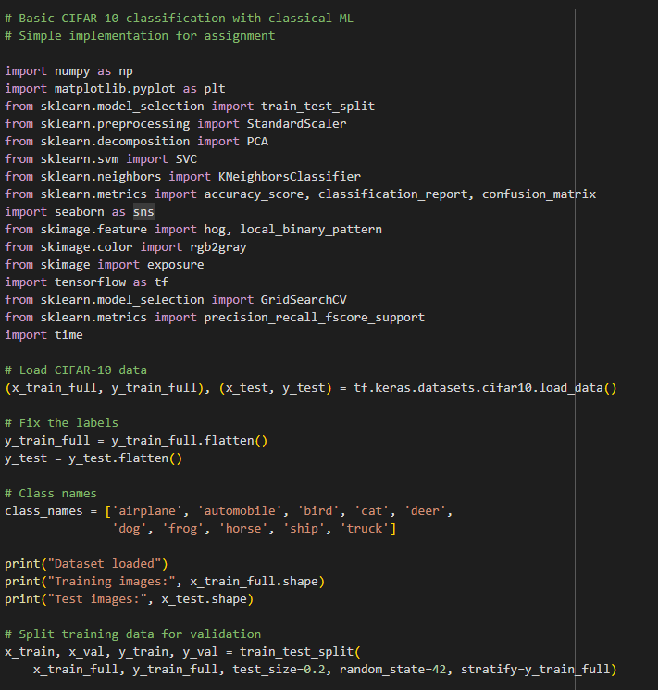
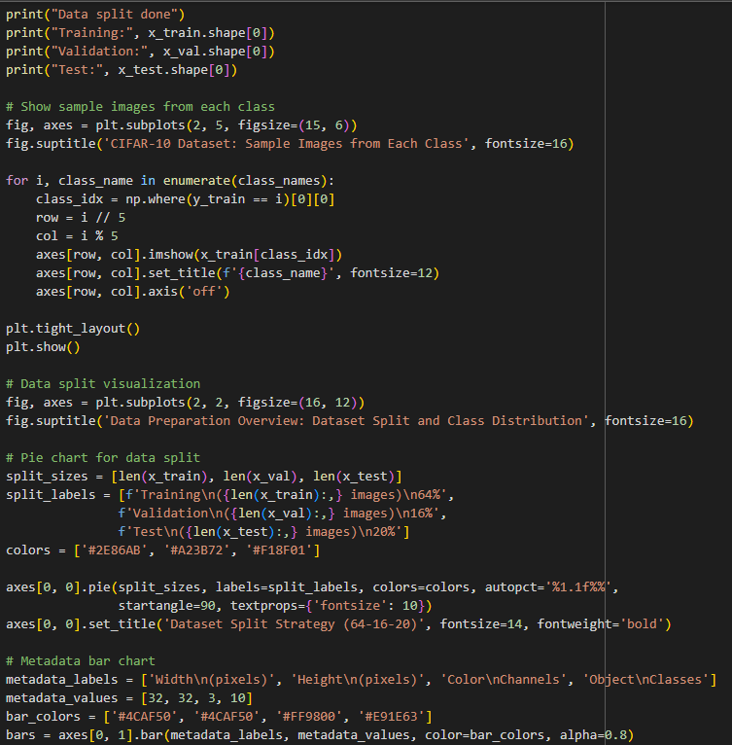
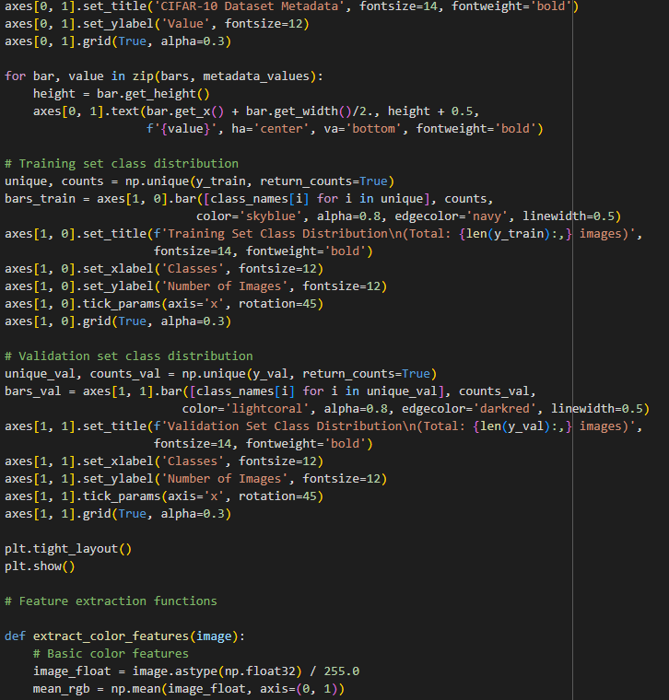
# Train models
print("Training models...")
Appendix A. 1/5
Phyton Code (Google Colab)

Slide 16
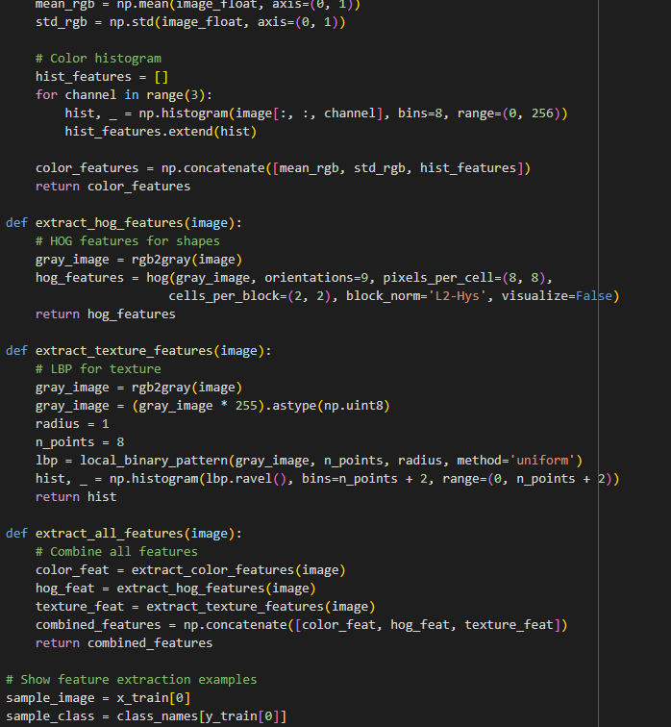
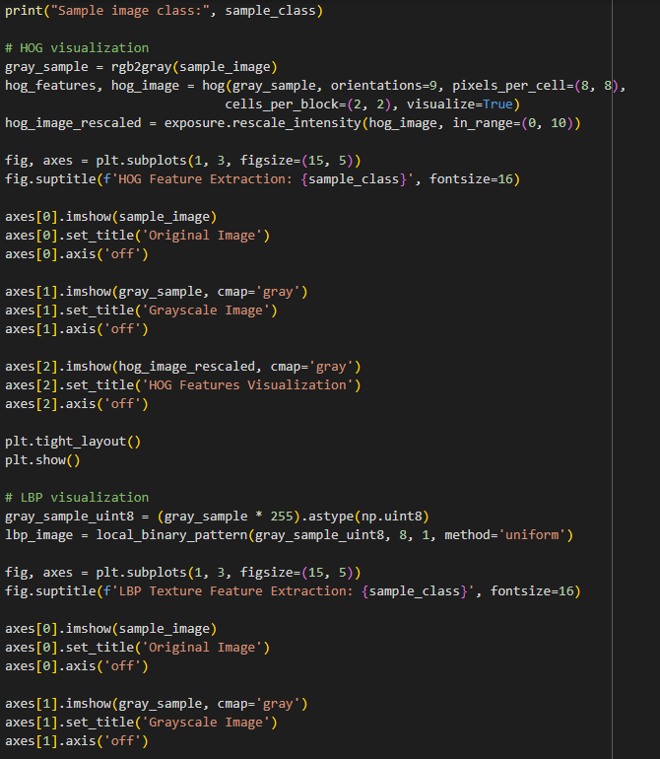
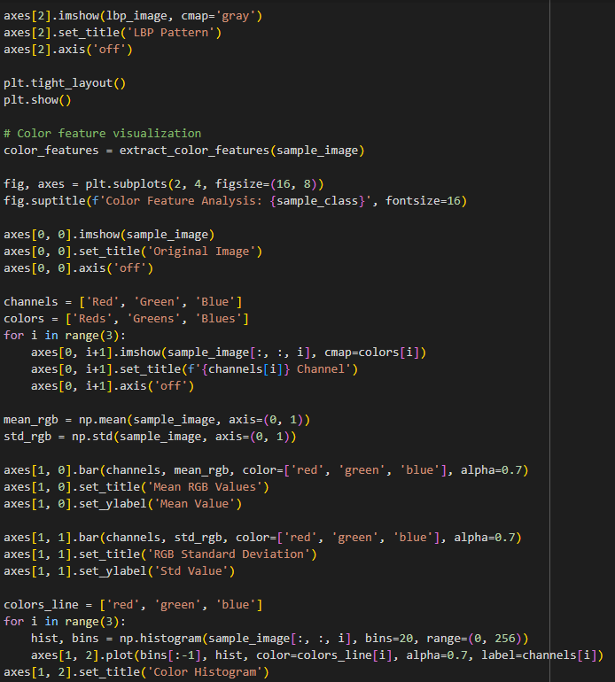
# Train models
print("Training models...")
Appendix A. 2/5
Phyton Code (Google Colab)

Slide 17
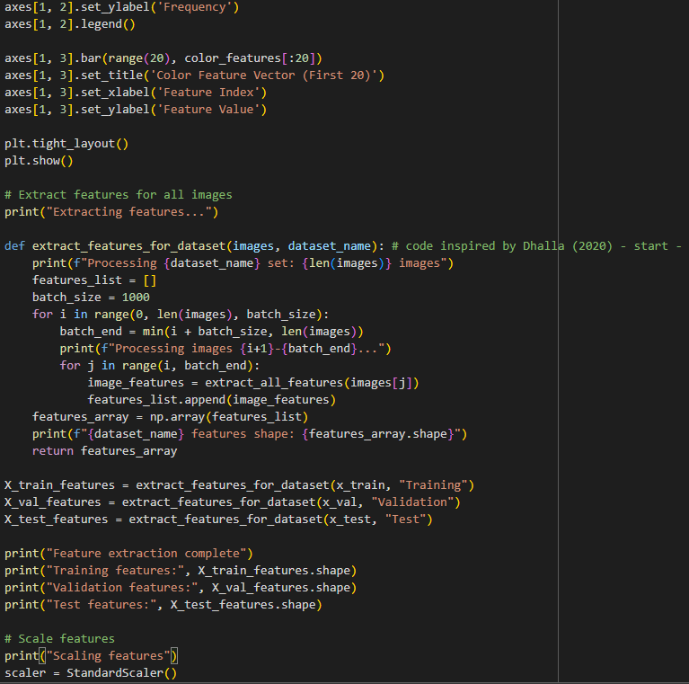
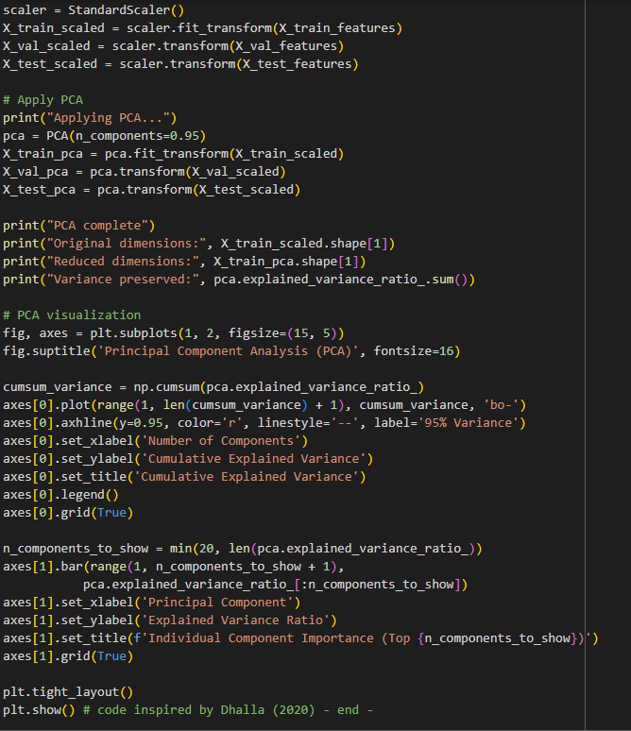
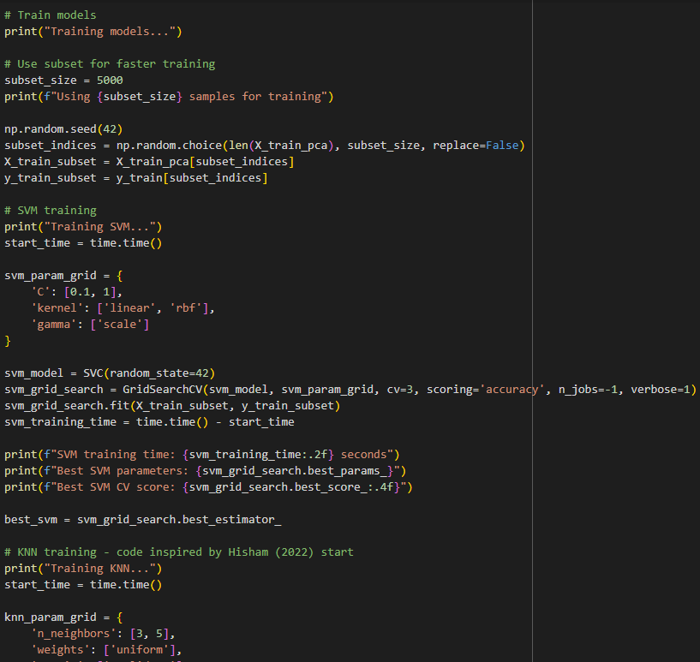
# Train models
print("Training models...")
Appendix A. 3/5
Phyton Code (Google Colab)

Slide 18
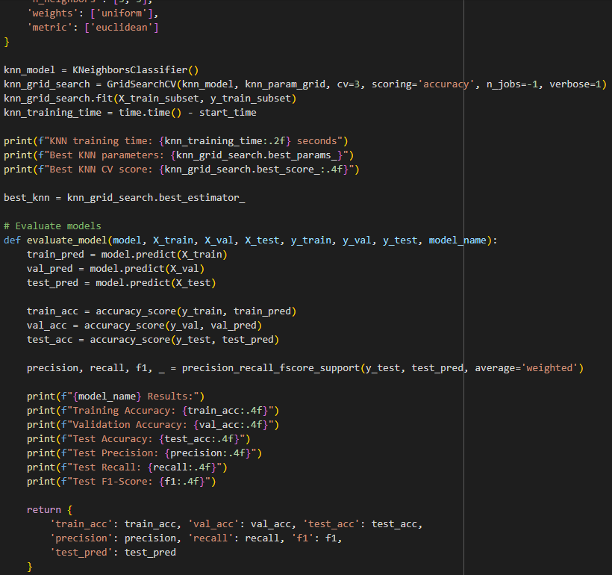
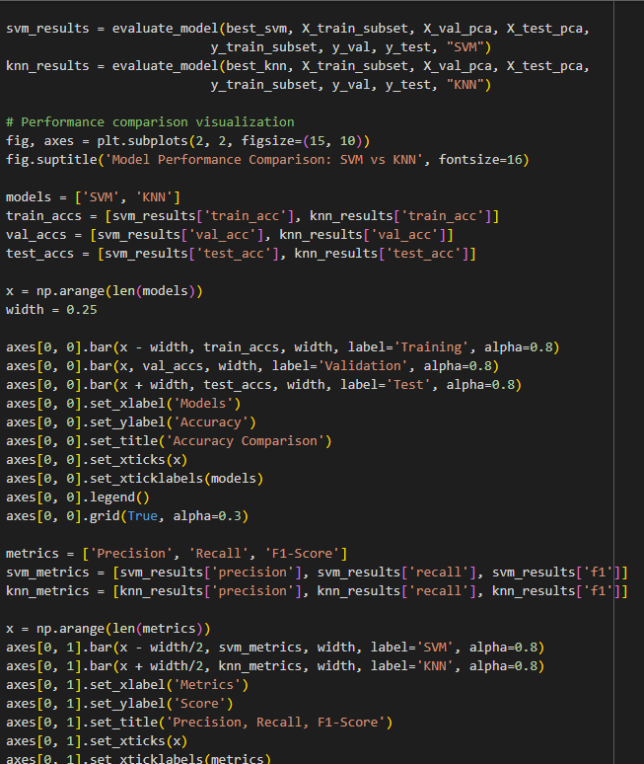
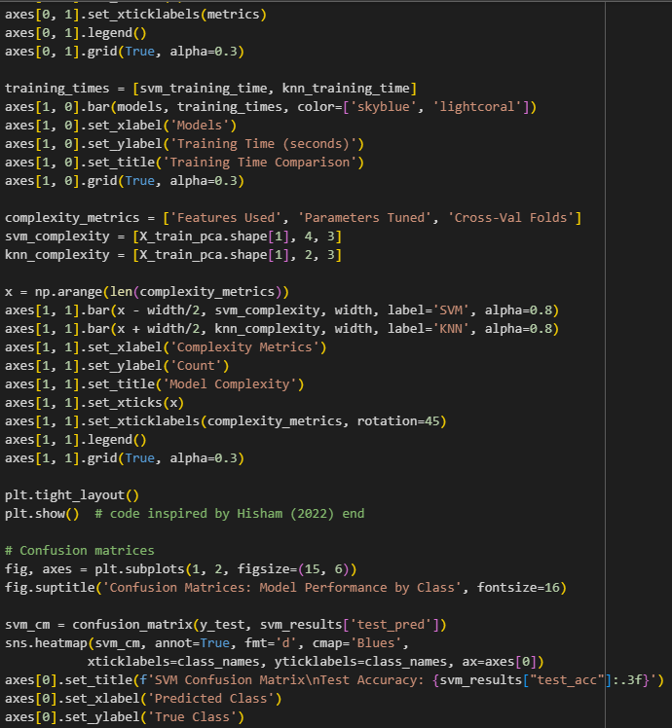
# Train models
print("Training models...")
Appendix A. 4/5
Phyton Code (Google Colab)

Slide 19
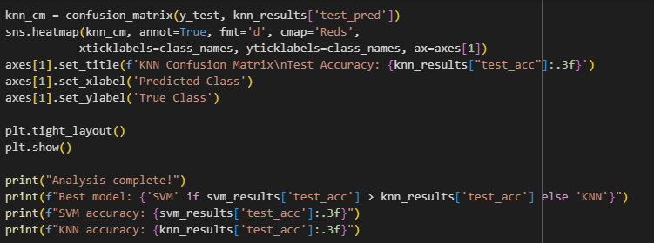
# Train models
print("Training models...")
Appendix A. 5/5
Phyton Code (Google Colab)

Slide 20
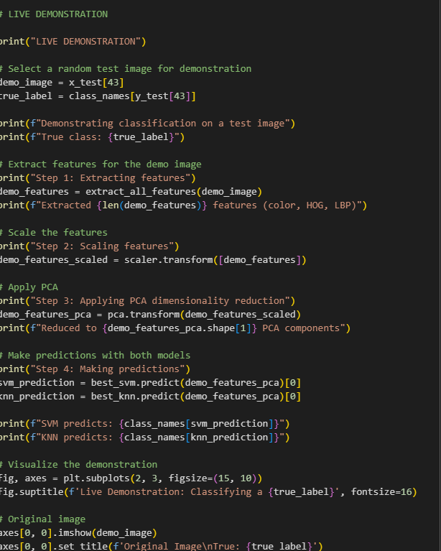
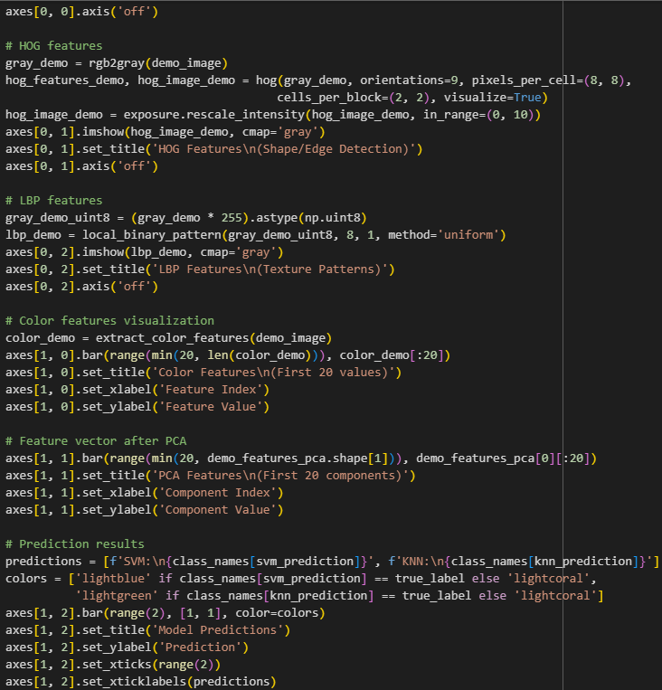
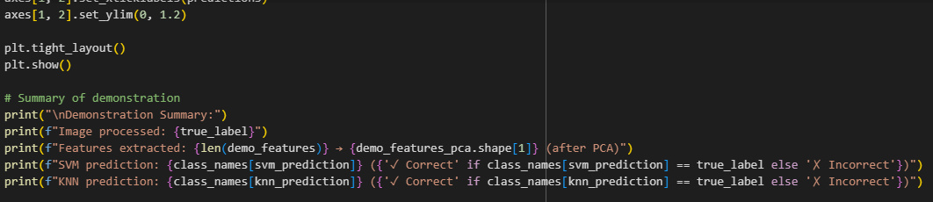
# Train models
print("Training models...")
Appendix B.
Phyton Code (Google Colab) – Live Demo.

Slide 21
Thank You
Student ID: 219155

